Slide 1

Deeplearning

Slide 2
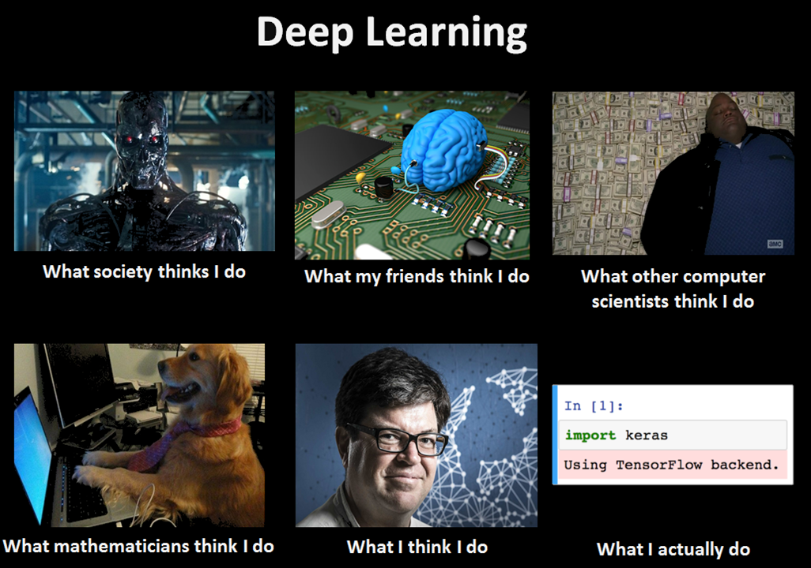

Slide 3
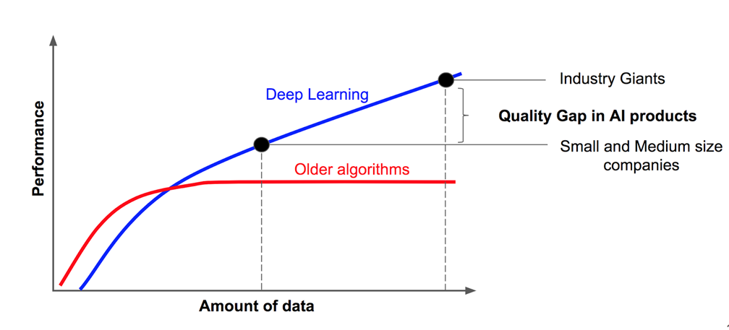

Slide 4
Classical Machine Learning:
Deep Learning:
Interpretability and explainability are paramount
Smaller amounts of relatively simple data
Straightforward feature engineering
Limited computational power
Limited time, need for faster prototyping and operationalization
Need for varied algorithm choices
Accuracy of test dataset results is acceptable
Very high accuracy is a priority (and primes over straightforward interpretability and explainability)
Large amounts of precisely labeled data
Complex feature engineering
Powerful compute resources available (GPU acceleration)
Augmentation and other transformations of the initial dataset will be necessary

Slide 5
History and basic concepts

Slide 6


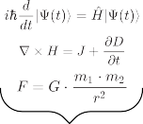

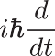
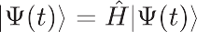
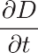

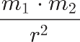







Slide 7


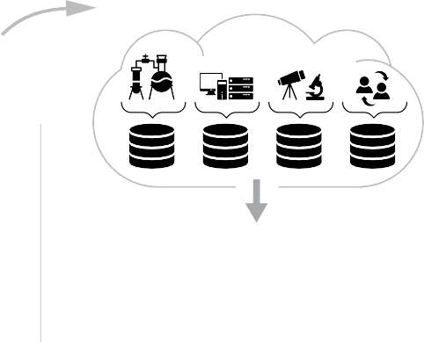


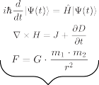

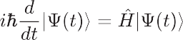


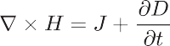
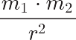




Slide 8
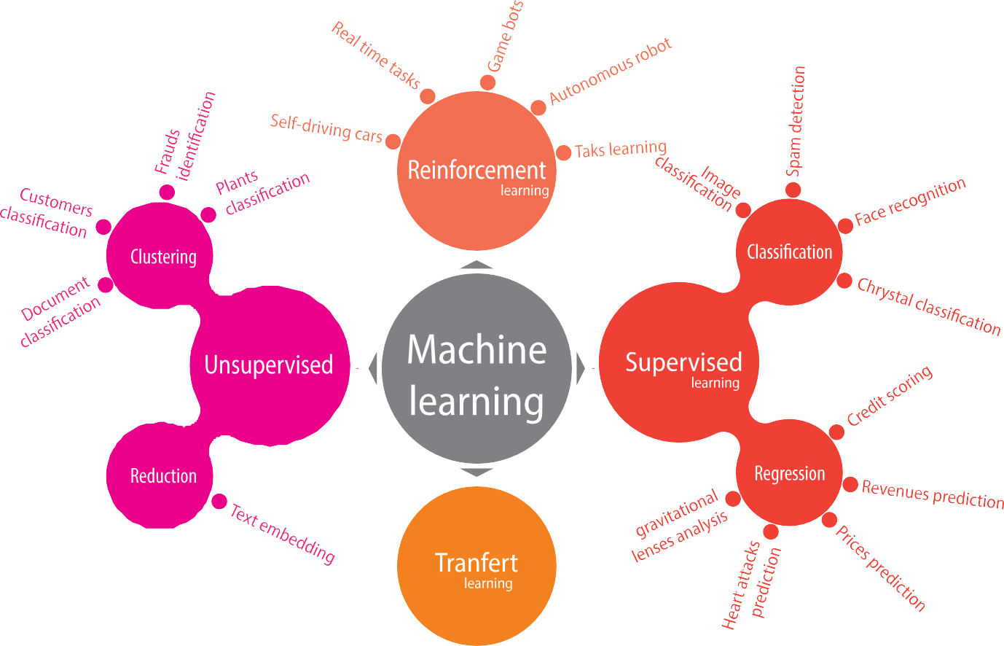

Slide 9
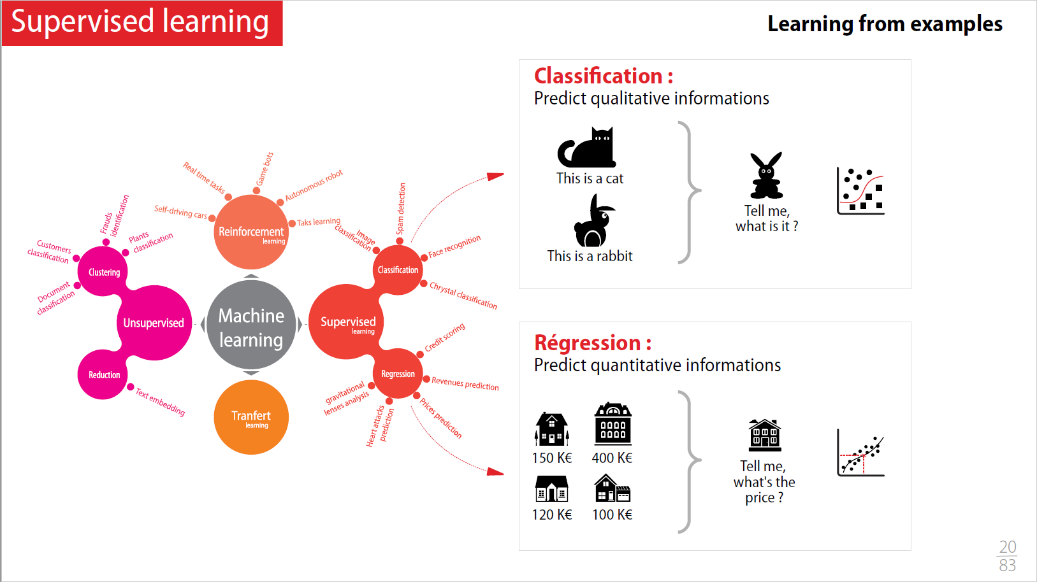

Slide 10

What is deeplearnig

Slide 11
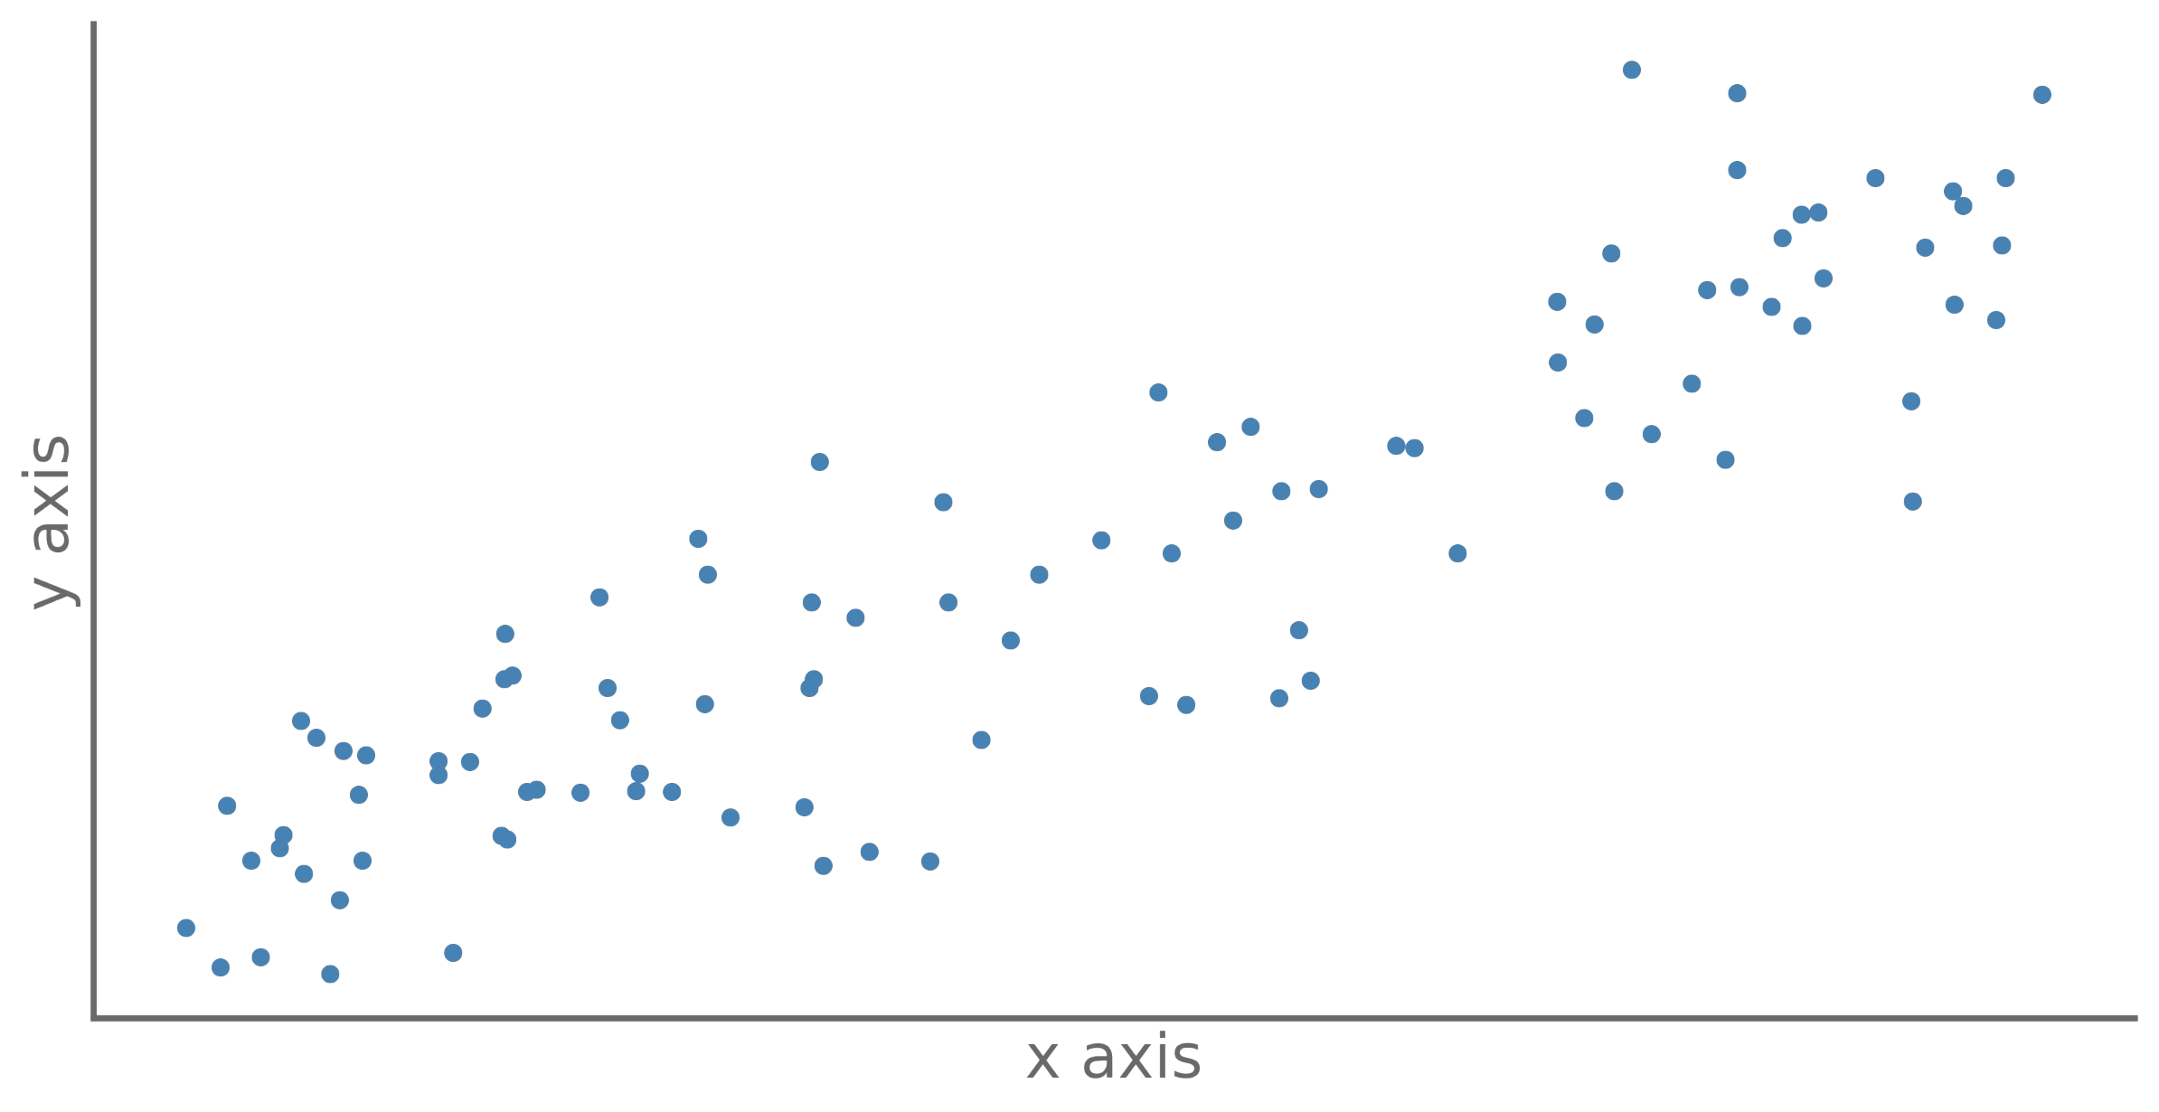
Linear regression
We have a phenomenon, for which we have observations

Slide 12
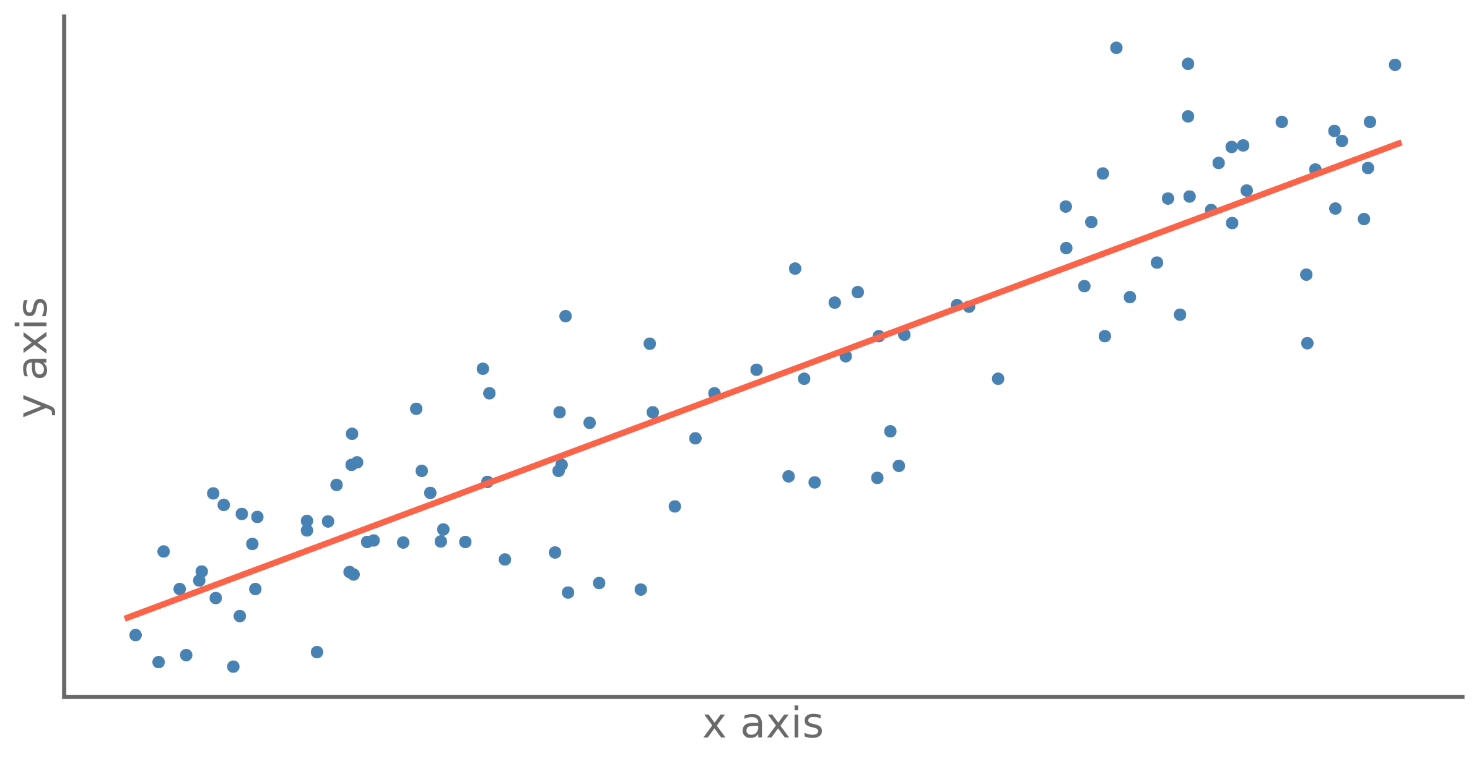

Linear regression
We are looking for a straight line that passes
« as close as possible » to our points.

Slide 13
Linear regression
"As close as possible" means "minimize the distance between the line and our points (observations)".

Slide 14
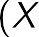

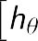
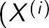


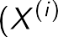
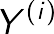
Linear regression
For this, we will use an «loss function », which we will try to minimize.
RMSE : Root Mean Square Error Erreur quadratique moyenne
MSE :
Mean Squared Error Moyenne du carré des erreurs

Slide 15

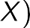
Linear regression
Good news !
We have a direct solution !
Bad news... Complexity in n³

Slide 16
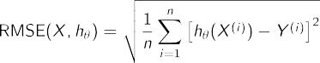

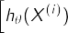
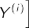
Gradient descent
Θ1
Loss
We will iteratively look for the best position of our line, by varying its parameters (Θ).
loss(Θ)
Θ1
Θ
Θ2
Θ1
But how can we efficiently vary our parameters (Θ)?
Loss
loss(Θ)
Θ2
Θ
Θ3
Note :
Loss functions could be :
Θ2
Θ1
Loss
loss(Θ)
Θ3
Θ

Slide 17

Gradient descent
By changing Θ from δΘ
We improve loss(Θ) of δloss
The gradient is the slope we will follow to minimize our loss function.
δ loss
Iterations
Loss
δ Θ
loss(Θ)
This process is called and
gradient descent
the function used to optimize the descent,
optimization
function
Best Θ
Θ

Slide 18
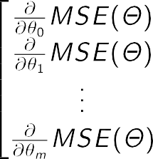
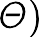




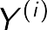


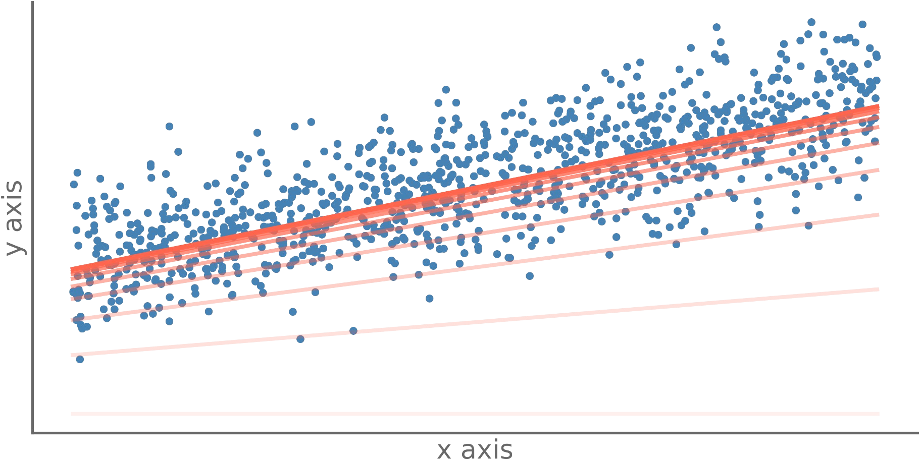
Gradient descent
n : number of observations m : number of characteristics
#i
Loss
Gradient
Theta
0 | +12.481 | -6.777 | -1.732 | -3.388 | +0.000
20 | +4.653 | -4.066 | -1.039 | -2.033 | +0.346
40 | +1.835 | -2.440 | -0.624 | -1.220 | +0.554
60 | +0.821 | -1.464 | -0.374 | -0.732 | +0.679
80 | +0.455 | -0.878 | -0.224 | -0.439 | +0.754
100 | +0.324 | -0.527 | -0.135 | -0.263 | +0.799
120 | +0.277 | -0.316 | -0.081 | -0.158 | +0.826
140 | +0.260 | -0.190 | -0.048 | -0.095 | +0.842
160 | +0.253 | -0.114 | -0.029 | -0.057 | +0.851
180 | +0.251 | -0.068 | -0.017 | -0.034 | +0.857
200 | +0.250 | -0.041 | -0.010 | -0.020 | +0.861
Notebook [GRAD1]

Slide 19
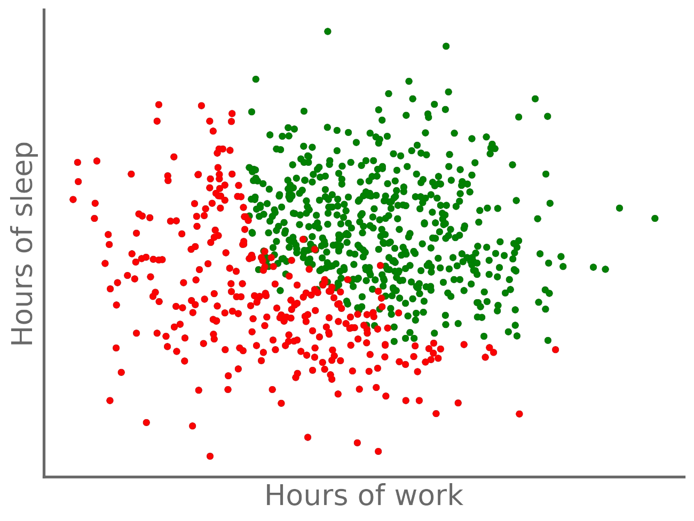
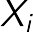
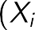
Logistic regression
A logistic regression is intended to provide a probability of belonging to a class.
Dataset :
X Observations y Classe
Notebook [LOGR1]

Slide 20
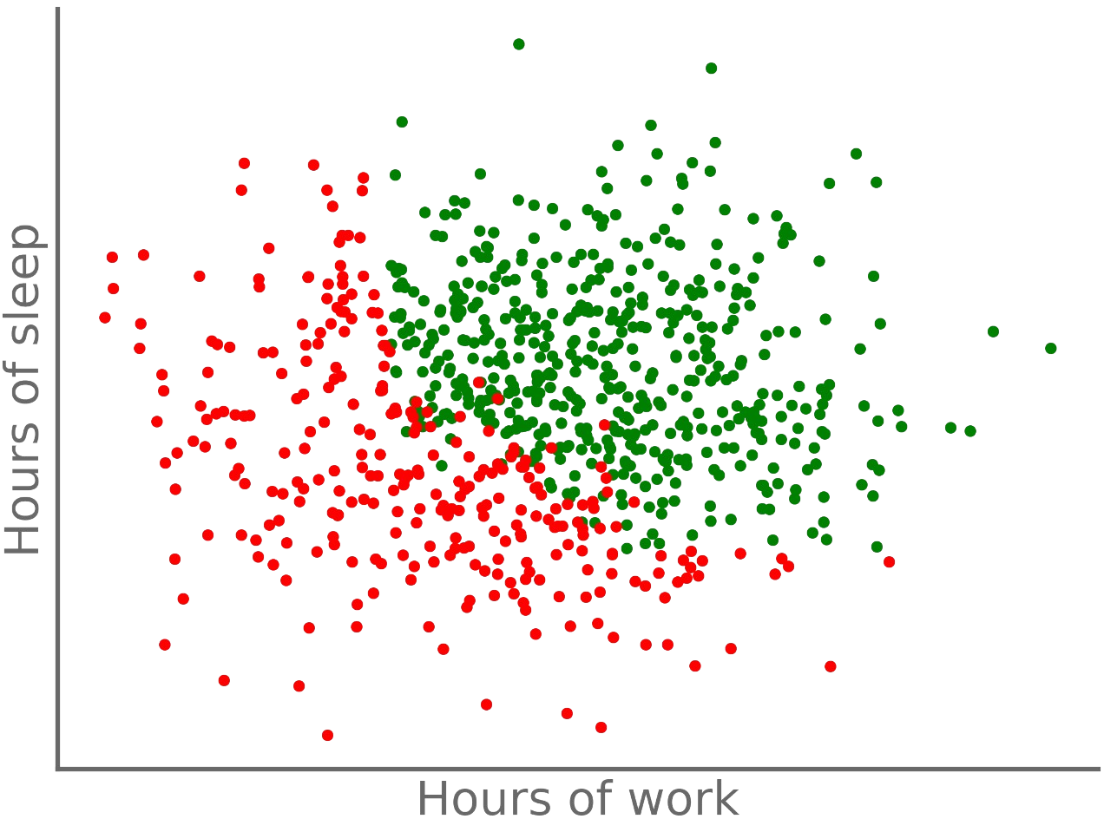
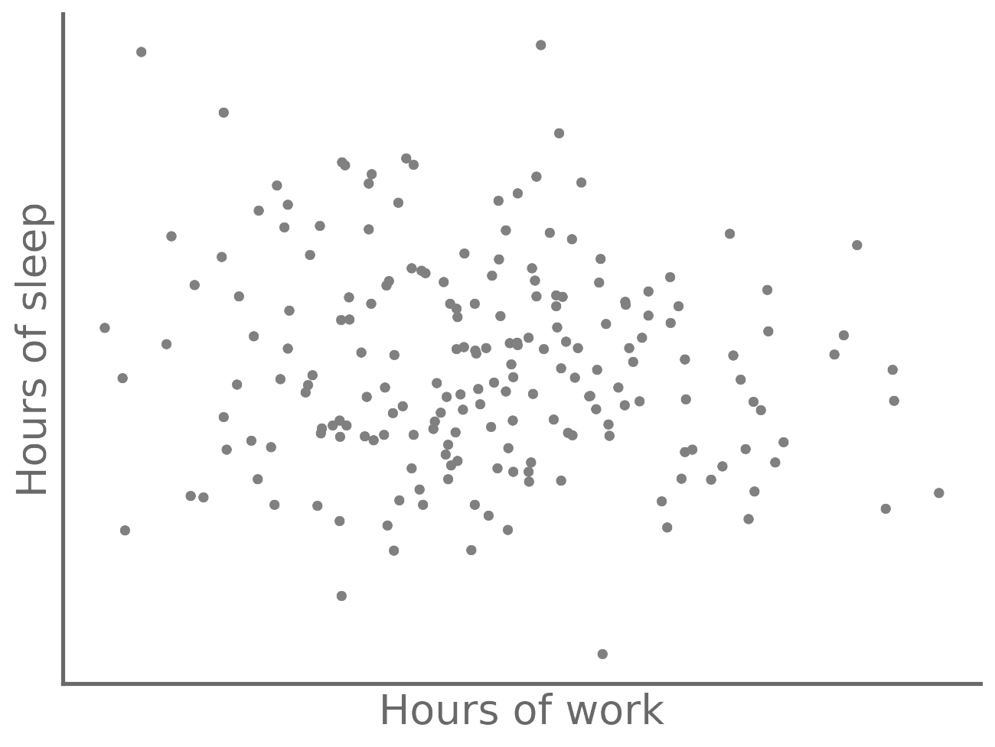

Logistic regression
A logistic regression is intended to provide a probability of belonging to a class.
Dataset :
X Observations Objective :
y Classe
Predict the class
x given, we want to predict y
y_{pred} = f(x)
where f is a linear function
?
Notebook [LOGR1]

Slide 21



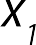

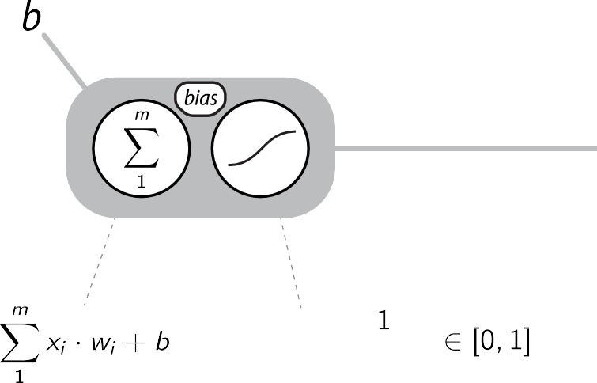
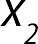
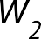
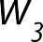
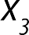
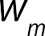
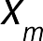






Logistic regression

Slide 22
Logistic regression
Determined by the minimisation of a cost function J(Θ)

Slide 23




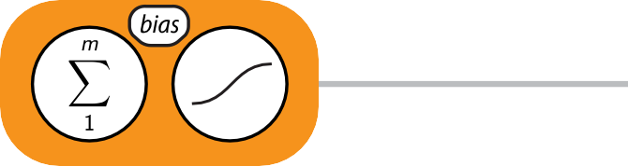

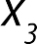
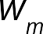

Logistic regression
That’s an « artificial neuron » !
So, we have a neural network of… 1 neuron !

Slide 24
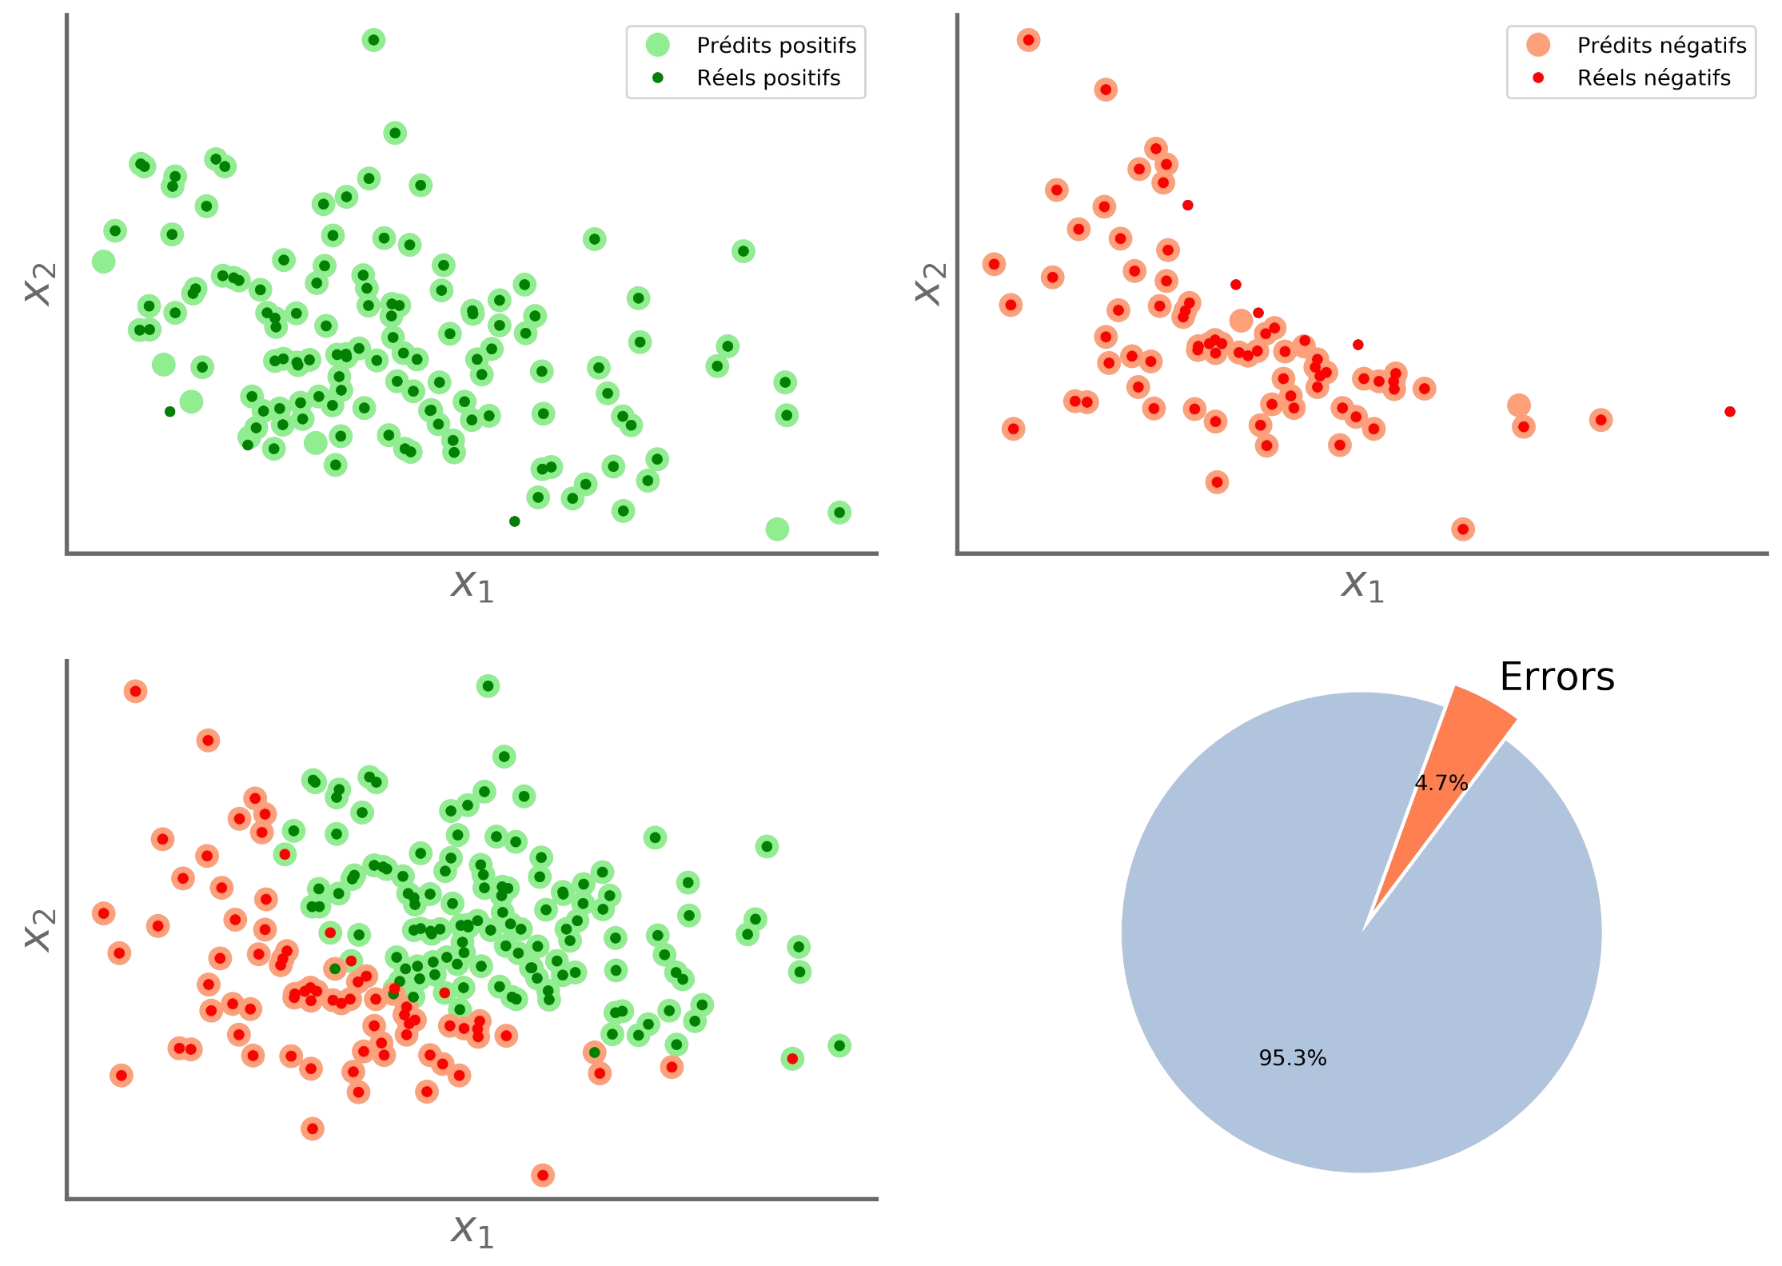
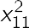
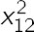
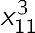
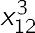

Logistic regression
Linear => Non linear

Slide 25
[ intelligence ]

Slide 26

[ intelligence ]
« Capacité de percevoir ou d'inférer
l'information,
connaissance
et de la conserver comme une
à appliquer à des
comportements dans un
adaptatifs
environnement ou un contexte donné »
« Ability to perceive or infer
information
, and to retain it
as to be appli towards
behaviors
knowledge
adaptive
within an environment or context »*
* Wikipedia - Illustration : [POTATO]

Slide 27



[ intelligence ]
a
4
« Ensemble des
fonctions
mentales ayant
pour objet la connaissance
conceptuelle
et
»*
rationnelle
« Set of mental functions aimed at conceptual and rational knowledge »
* https://www.larousse.fr

Slide 28

Modelling the brain :
The big
Controversy
Making a mind :
« Penser, c’est calculer des symboles qui ont à la fois une réalité matérielle et une valeur sémantique de représentation »¹
L’information est une donnée symbolique de haut niveau.
« Penser s’apparente
à un calcul massivement parallèle de
fonctions élémentaires.
L’information est un signal avant d’être un code »¹
Connectionnism
Modelling the brain Modéliser le cerveau
Symbolic
Making a mind Forger une opinion
vs
Tout [homme] est [mortel] [Socrate] est un [homme]
Donc [Socrate] est [mortel]
¹ Dominique Cardon, Jean-Philippe Cointet, Antoine Mazieres (2018) [LRDN]

Slide 29

Illustration : [NEURON]

Slide 30
Modelling the brain :
The big
Controversy
Making a mind :
« Penser, c’est calculer des symboles qui ont à la fois une réalité matérielle et une valeur sémantique de représentation »¹
L’information est une donnée symbolique de haut niveau.
« Penser s’apparente
à un calcul massivement parallèle de
fonctions élémentaires.
L’information est un signal avant d’être un code »¹
Connectionnism
Modelling the brain Modéliser le cerveau
Symbolic
Making a mind Forger une opinion
vs
Tout [homme] est [mortel] [Socrate] est un [homme]
Donc [Socrate] est [mortel]
¹ D Cardon, JP Cointet, A Mazieres, 2018 [LRDN]

Slide 31









Connectionnism
The big
Controversy
vs
Symbolic
Facts
Rules and laws
Expert
Model
Rules and laws
Special case

Slide 32

The big
Controversy
Evolution of the academic influence of connexionist and symbolic approaches¹
Ration of publications between connexionists and symbolists
65 522 publications
106 278 publications
¹ D Cardon, JP Cointet, A Mazieres, 2018 [LRDN]

Slide 33
Evolution of the academic influence of connexionist and symbolic approaches¹
The big
Controversy
First concept of artificial neural network McCulloch, Pitts 1943
Perceptron
ONR
Rosenblatt 1957
Macy conferences 1941-1960
65 522 publications
106 278 publications
¹ D Cardon, JP Cointet, A Mazieres, 2018 [LRDN]

Slide 34






Perceptron
Perceptron Frank Rosenblatt
1958
Linear and binary classifier
F. Rosenblatt, 1958 [FROS]

Slide 35

Perceptron
Iris plants dataset
Dataset from : Fisher, R.A. “The use of multiple measurements in taxonomic problems” Annual Eugenics, 7, Part II, 179-188 (1936)
Length | Width | Iris | Setosa | (0/1)
x₁ | x₂ |  | y
1.4 | 1.4 |  | 1
1.6 | 1.6 |  | 1
1.4 | 1.4 |  | 1
1.5 | 1.5 |  | 1
1.4 | 1.4 |  | 1
4.7 | 4.7 |  | 0
4.5 | 4.5 |  | 0
4.9 | 4.9 |  | 0
4.0 | 4.0 |  | 0
4.6 | 4.6 |  | 0
(...)
Notebook [PER57]

Slide 36
Evolution of the academic influence of connexionist and symbolic approaches¹
The big
Controversy
MIT (Minsky, Papert) CM (Simon, Newel) Stanford (McCarthy) DARPA
Perceptrons Minsky, Papert 1969
Artificial Intelligence Darmouth workshop McCarthy
1956
First AI Winter Mansfield amendment (1969)
65 522 publications
106 278 publications
Lighthill report (1973)
¹ D Cardon, JP Cointet, A Mazieres, 2018 [LRDN]

Slide 37
Evolution of the academic influence of connexionist and symbolic approaches¹
The big
Controversy
Backprop. Rumelhart 1986
Convol. NN
LeCun 1989
Extinction of LISP machines
First AI Winter Mansfield amendment (1969)
Lighthill report (1973)
Expert systems
65 522 publications
106 278 publications
¹ D Cardon, JP Cointet, A Mazieres, 2018 [LRDN]

Slide 38

Deep Neural Networks

Slide 39


Slide 40




















Slide 41


Slide 42


















Deep Neural Networks
Input layer
Hidden layers
Output layer

Slide 43






Deep Neural Networks
No activation function
^{X}(i)
^{y}(i)
Train set
X_{(i)} : Observations
y_{(i)} : Expected output
(Normalized)

Slide 44













Deep Neural Networks
To define :
Optimization Activation Loss
Metrics
Back-propagation
Learning process
...

Slide 46


Slide 47


Slide 48


Slide 49


Slide 50


Slide 51

Fonctions d’activation

Slide 52


Slide 54

Evolution of the academic influence of connexionist and symbolic approaches¹
The big
Controversy
Backprop. Rumelhart 1986
Convol. NN
LeCun 1989
Extinction of LISP machines
Expert systems
65 522 publications
106 278 publications
¹ D Cardon, JP Cointet, A Mazieres, 2018 [LRDN]

Slide 55
Evolution of the academic influence of connexionist and symbolic approaches¹
The big
Controversy
Support Vector Machine (SVM) Vapnik
1995
2nd Winter (For DL)
65 522 publications
106 278 publications
¹ D Cardon, JP Cointet, A Mazieres, 2018 [LRDN]

Slide 56

Images classification Top 5 error at ILSVRC 2012
The big
Controversy
Publications SVM vs DNN¹
3,4
18 000
0,4
SVM DNN
AlexNet²
A. Krizhevsky,
I. Sutskever,
G. Hinton
2012 ILSVRC
Top5 error : 26 % 🞂 15 %
16 000
0,35
0,3
0,25
14 000
12 000
DNN
0,2
Top 5 errors
0,15
Publications
10 000
0,1
0,05
Real humans
8 000
0
6 000
AlexNet
ISI
XRCE/INRIA
Amsterdam
XRCE/INRIA
LEAR-XRCE
OXFORD_VGG
2nd Winter (For DL)
Real human
4 000
Without mathematical guarantee, DNN have proven to be more effective in the face of the complexity of the real
2 000
0
1990
1995
2000
2005
2010
2015
2020
world !
¹ Web of Science [WOS1][WOS2]
² AlexNet [ALEX]
³ ImageNet Large Scale Visual Recognition [ILSVRC]
⁴ Similar evolution in Natural language processing, translation, board games, etc. See : DeepL.com, AlphaGo, AlphaZero, ...

Slide 57
Regression with a DNN
No activation function
^{X}(i)
^{y}(i)
Train set
X_{(i)} : Observations
y_{(i)} : Expected output
(Normalized)

Slide 58
Training process - general
To define : Optimization Activation Loss
Metrics
...

Slide 59





Training process - general
(batch)

Slide 60




BHPD1
^{X}test
50s
(5 epochs)
Test set
y
test
^{X}train ^{y}train
Import and init
Train set
Preparing the data
Train the model
START
Step 1
Step 2
Step 3
Step 4
Step 5
Step 6
END
Objectives :
Load dataset
Create model
Evaluate
Make a first
regression
€
via a DNN network
dataset

Slide 61













Classification with a DNN
(Normalized)

Slide 62

Overfiting

Slide 63


Slide 64

Model evaluation
Basic learning process
:

Slide 65

Model evaluation
We will adapt our model according to the test data !
Basic learning process
:

Slide 66

Hold-out evaluation
Validation simple
Suitable for large datasets, allowing for large Validation and Test sets.
If the Validation/Test sets are too small, the final evaluation will be statistically unstable.

Slide 67

Iterative hold-out evaluation with shuffling
Suitable for
medium sized datasets
: generating a shuffled dataset can be expensive...
The number of iterations depends on the data.

Slide 68

K-fold cross validation
Validation croisée
Very interesting strategy for small datasets.
If the amount of data is small, however, the result can remain unstable...

Slide 69

Iterated K-fold cross validation with shuffling
Probably the
best strategy
for small datasets...
...but if K and n are important, the combination can become very expensive !

Slide 70
A few questions to keep in mind !
Are my data subsets (train, test, ...) of my data?
representative
Can
I or I shuffle my data? (time sequences, ordered data, ...)
should
Within the dataset, what is the share and impact of outliers?
What is the of my data (measurement, sample, ...)
accuracy
How many folds, how many do I need ?
iterations
How much data do I need?
?

Slide 71
Roadmap
Text encoding
3.1
➔
From text to tensor One hot encoding Embedding
➔
➔
3
3.2
Example 1 : IMDB1
➔
Sentiment analysis with one-hot encoding
Sparse data Embedding
Example 2 : IMDB2/3/4
3.3
➔
Sentiment analysis with embedding

Slide 72
Roadmap
Text encoding
3.1
Please note that this is an extremely large subject and this is only an introduction !
➔
From text to tensor One hot encoding Embedding
➔
➔
3
3.2
Example 1 : IMDB1
➔
Sentiment analysis with one-hot encoding
Sparse data Embedding
Example 2 : IMDB2/3/4
3.3
➔
Sentiment analysis with embedding

Slide 73



How to feed a neural network with text ?
Variable size Large size space
Conceptual contents ;-)
...
?
?

Slide 74
One hot encoding
« I've never seen a movie like this before. »
How to build a descriptor for this kind of data (text, DNA, ...)?

Slide 75
One hot encoding
« I've never seen a movie like this before. »
Tokenization (words)
["i've", 'never',
'seen',
'a',
'movie', 'like',
'this', 'before']
0 | a
1 | before
2 | fantastic
3 | i’ve
4 | is
5 | like
6 | movie
7 | never
8 | seen
9 | this
Dictionary
Note: The word order in the dictionary may have some meaning. For example according to their rate of use

Slide 76

One hot encoding
« I've never seen a movie like this before. »
Tokenization (words)
Dictionary
["i've", 'never',
'seen',
'a',
'movie', 'like',
'this', 'before']
0 | a
1 | before
2 | fantastic
3 | i’ve
4 | is
5 | like
6 | movie
7 | never
8 | seen
9 | this
Vectorization
[ 3,
7,
8,
0,
6,
5,
9, 1 ]
The values associated with each word are meaningless: words with a contiguous subscript are typically unrelated.

Slide 77
One hot encoding
« I've never seen a movie like this before. »
Tokenization (words)
["i've", 'never',
'seen',
'a',
'movie',
'like',
'this', 'before']
[ 3,
7,
8,
0,
6,
5,
9, 1 ]
Vectorization
Dictionary
0 | a
1 | before
2 | fantastic
3 | i’ve
4 | is
5 | like
6 | movie
7 | never
8 | seen
9 | this
0
0
0
0
0
0
0
0
0
0
0
0
0
0
0
0
0
0
1
0
0
0
0
0
0
0
0
0
0
0
0
0
0
0
0
0
0
0
0
0
0
0
0
0
0
0
0
0
0
1
0
0
0
0
0
0
0
0
1
001000
One hot encoding
0
0
0
0
0
0
1
1
0
0
0
0
1
0
0
0
Each vector is independent.
0
0
1
Each word has its dimension.
own
0
1

Slide 78
One hot encoding
« I've never seen a movie like this before. »
Tokenization (words)
["i've", 'never',
'seen',
'a',
'movie',
'like',
'this', 'before']
[ 3,
7,
8,
0,
6,
5,
9, 1 ]
Vectorization
Dictionary
0 | a
1 | before
2 | fantastic
3 | i’ve
4 | is
5 | like
6 | movie
7 | never
8 | seen
9 | this
0
0
0
0
0
0
0
0
0
0
0
0
0
0
0
0
0
0
1
0
0
0
0
0
0
0
0
0
0
0
0
0
0
0
0
0
0
0
0
0
0
0
0
0
0
0
0
0
0
1
0
0
0
0
0
0
0
0
1
001000
One hot encoding
0
0
0
0
1
1
0
0
0
0
1
0
0
0
Each vector is independent.
0
0
0
0
1
Each word has its dimension.
own
0
1

Slide 79
One hot encoding
Limits of full one-hot encoding :
0 0 | 0 | 1 0 | 0 | 0 | 0
0 0 | 0 | 0 0 | 0 | 0 | 0
0 0 | 0 | 0 0 | 0 | 0 | 0
0 0 | 0 | 0 0 | 0 | 0 1
0 0 | 0 | 0 0 | 0 | 0 | 0
0 0 | 0 | 0 0 | 0 | 0 | 0
0 0 | 0 | 0 0 | 0 | 0 | 0
0 0 | 0 | 0 0 | 0 | 0 | 0
1 0 | 0 | 0 0 | 0 | 0 | 0
0 0 | 0 | 0 0 | 0 | 0 | 0
0 0 | 0 | 0 0 | 1 | 0 | 0
0 0 | 0 | 0 0 | 0 | 0 | 0
0 0 | 0 | 0 1 | 0 | 0 | 0
0 0 | 0 | 0 0 | 0 | 0 | 0
0 1 | 0 | 0 0 | 0 | 0 | 0
0 0 | 0 | 0 0 ... | 0 | 0 | 0
0 0 | 1 | 0 0 | 0 | 0 | 0
0 0 | 0 | 0 0 | 0 | 0 | 0
0 0 | 0 | 0 0 | 0 | 1 | 0
0 0 | 0 | 0 0 | 0 | 0 | 0
Example :
Dictionary | = | 80 000 words
Sentence | = | 300 words
Need :
24 10⁶
Parameters !
One hot vector
2 answers :
Embedding

Slide 80

One hot vector encoding
Solution 1 : one hot vector
0 0 0 1 0 0 0 0
0 0 0 0 0 0 0 0
0 0 0 0 0 0 0 0
0 0 0 0 0 0 0 1
0 0 0 0 0 0 0 0
0 0 0 0 0 0 0 0
0 0 0 0 0 0 0 0
0 0 0 0 0 0 0 0
1 0 0 0 0 0 0 0
0 0 0 0 0 0 0 0
0 0 0 0 0 1 0 0
0 0 0 0 0 0 0 0
0 0 0 0 1 0 0 0
0 0 0 0 0 0 0 0
0 1 0 0 0 0 0 0
0 0 0 0 0 0 0 0
1
0
0
1
0
0
0
0
1
0
1
0
1
0
1
0
… 1
0
1
0
1 This word is not present in the sentence
0 This word is present in the sentence
Logical OR on each line
…
0 0 1 0 0 0 0 0
0 0 0 0 0 0 0 0
0 0 0 0 0 0 1 0
0 0 0 0 0 0 0 0
Vector size = Dictionary size
The size no longer depends on the length of the sentence.
The size is drastically reduced, but we lose the words order.

Slide 81
Embedding
Solution 2 : Using embedding
Semantic meaning, allows to perform calculations, such as :
0
0
0
0
0
0
0
0
1
0
0
0
0
0
… 0
0
0
0
0
Cat
Sénégal
Dakar
(Wordi )
(Wi)
0.34
4.2
1.57
France
Paris
Short
dense vector,
whose value carries a semantic meaning of the word.
dist( "France", "Cat") >> dist("France", "Sénégal")
vect( "France", "Paris" ) ≈ vect( "Sénégal", "Dakar" ) "Paris" = "France" + vect( "Sénégal", "Dakar" )
Long sparse vector, whose value just
« Paris est à la France ce que Dakar est au Sénégal »
indicates membership
in the dictionary

Slide 82
Embedding
Solution 2 : Using embedding
Number of parameters required :
0
0
0
0
0
0
0
0
1
0
0
0
0
0
… 0
0
0
0
0
Example :
Embedding size : 200
Sentence size : 300 words
Need only : 60.000
Parameters :-)
(Wordi )
(Wi)
0.34
4.2
1.57
Short
dense vector,
whose value carries a semantic meaning of the word.
Embedding techniques :
Contextual embedding
Keras embedding
CBOW, SG,
GloVe,
Long sparse vector, whose value just
Global embedding
indicates membership
in the dictionary
etc.

Slide 83
Word Embedding
Word2Vec
Approche ayant pour objectif de constituer des dictionnaires dont la représentation
vectorielle des mots est basée sur le contexte et donc de la sémantique.
Des dictionnaires construits à partir de gros corpus sont disponibles.
Deux modèles :
Continuous Bag-of-Words (CBOW),
Skip-Gram (SG).
¹ Tomas Mikolov & all, (2013), [W3VEC]
CBOW :
Continuous Bag of Words - Embedding based
on the prediction of the word according to its context.
Skip-gram - Embedding based on context prediction from the word.
SG :

Slide 84

Continous Bag-of-Words
The objective of training is to (re)find a word from its context.
k = Bag of words size n = Dense vector size m = Dictionary size

Slide 85

Skip-Gram
k = Bag of words size n = Dense vector size m = Dictionary size
The objective of training is to (re)find the context from the word.

Slide 86
Word Embedding
GloVe¹
Contrairement à Word2vec, GloVe ne repose pas uniquement sur des statistiques locales (informations sur le contexte local des mots), mais intègre des statistiques globales (co-occurrence des mots) pour obtenir des vecteurs de mots.
¹ Jeffrey Pennington & all, (2014), [GLOVE]
Training is performed on aggregated global word-word co-occurrence statistics
36 44

Slide 87
Word Embedding
(Flau)BERT¹
2018
BERT est une représentation du langage proposée par Google en 2018, permettant de prendre en compte la dimension contextuelle du langage (« Avocat », peut être un fruit ou un juriste..).
FlauBERT² est une adaptation de l’algorithme au français.
To be continued !
¹ BERT: Pre-training of Deep Bidirectional Transformers for Language Understanding.
Jacob Devlin, Ming-Wei Chang, Kenton Lee, Kristina Toutanova https://arxiv.org/abs/1810.04805
² FlauBERT: Unsupervised Language Model Pre-training for French. Hang Le, Loïc Vial, Jibril Frej, Vincent Segonne, Maximin Coavoux, Benjamin Lecouteux, Alexandre Allauzen, Benoît Crabbé, Laurent Besacier, Didier Schwab https://arxiv.org/abs/1912.05372

Slide 88





Understanding hot-one encoding
Import and init
About our dataset
Build the model
Evaluate
START
Step 1
Step 2
Step 3
Step 4
Step 5
Step 6
Step 7
Step 8
END
Objectives :
Analysis of
Retrieve data
One-hot vector encoding
Train the model
film reviews
train
with
IMDB
test
One-Hot
(0,1,0,0,1, ...)
encoding
42
44

Slide 89


IMDB2 | IMDB3 | IMDB4
<60 s
Import and init
Preprocess the data (padding)
Train the model
START
Step 1
Step 2
Step 3
Step 4
Step 5
Step 6
END
Objectives :
Analysis of film
Retrieve data
Build a model
Evaluate
train
reviews
IMDB
test
with Keras embedding

